Slide 1
OOP LAB PROJECT ATM MACHINE
HARIKANT (FA18-BSCS-0122)
AHSAN (FA18-BSCS0033)
AADARSH KHATRI (FA18-BSCS-00129)

Slide 2
Description
In Java, we can create an ATM program for representing ATM transection. In the ATM program, First the program ask from user enter Debit card number and password, the user has to select an option from the options displayed on the screen. The options are related to withdraw the money, deposit the money, check the balance, and exit.
We use two methods in this program one is transaction method in this we use some methods like:
To withdraw the money, we simply get the withdrawal amount from the user.
To deposit the money, we simply get the deposit amount from the user, add it to the total balance and print the successful message.
To check balance, we simply print the total balance of the user.
Another transaction method is for new transaction.

Slide 3
Use java pillars
Encapsulation
Inheritance
Polymorphism

Slide 4
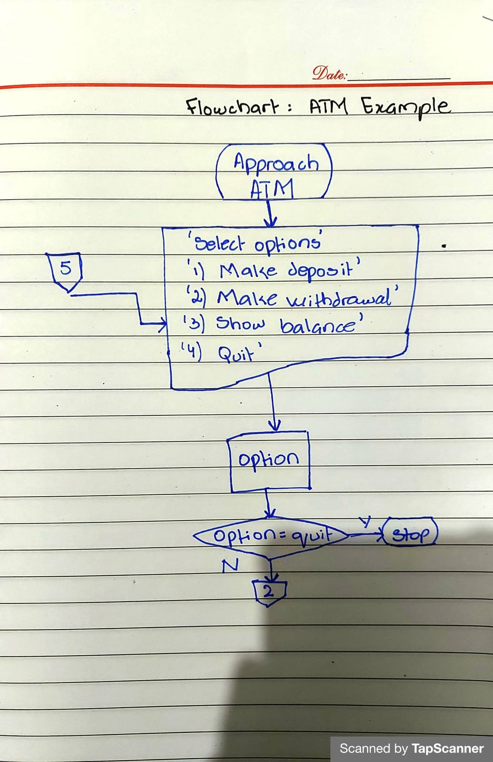
Flowchart

Slide 5
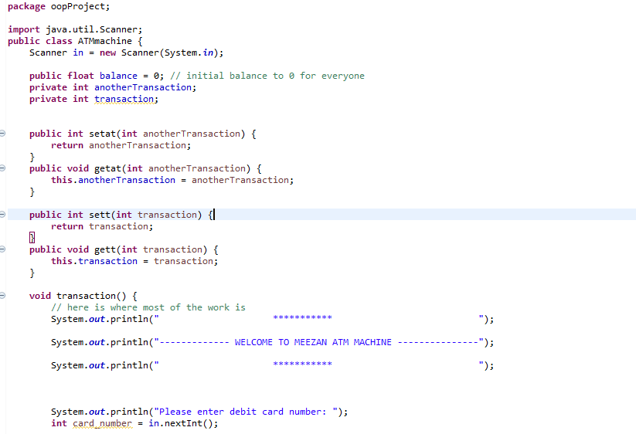
ATMmachine

Slide 6
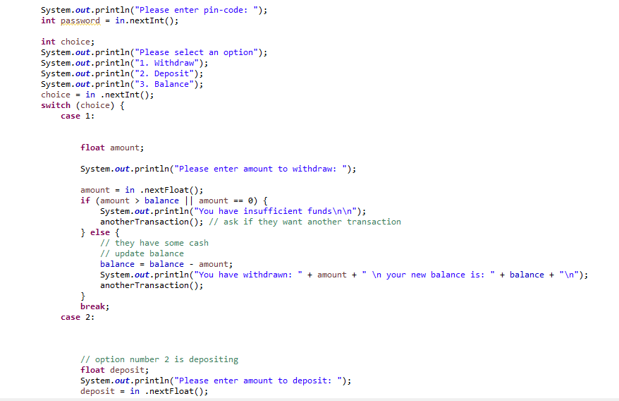

Slide 7
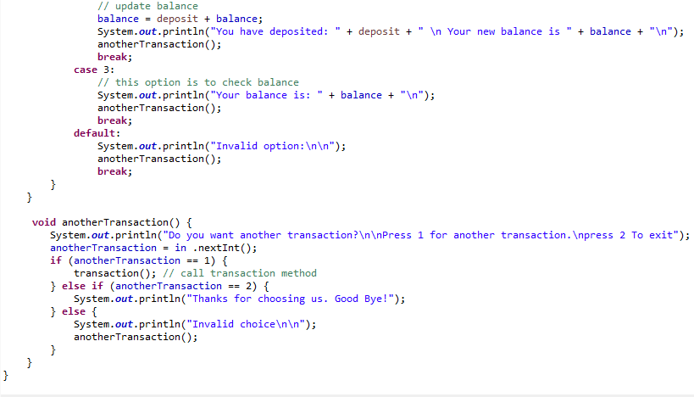

Slide 8
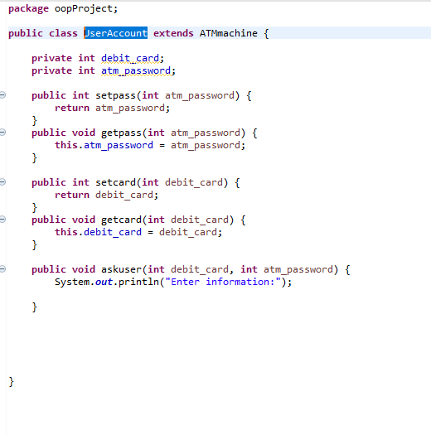
UserAccount

Slide 9
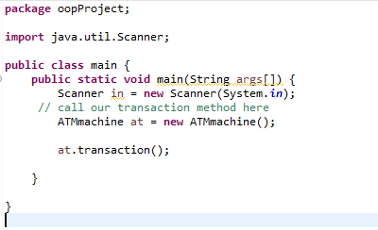
main

Slide 10
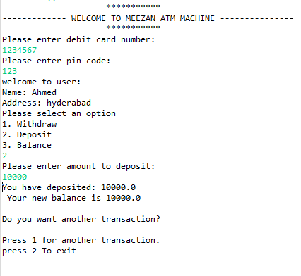
Output

Slide 11
Thankyou

